Slide 1
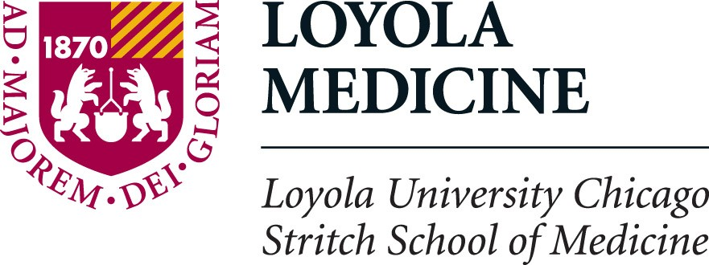

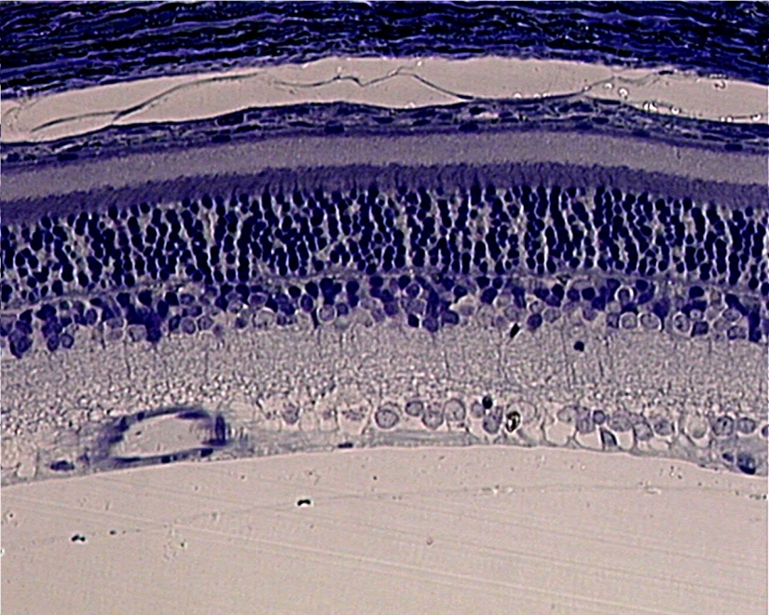
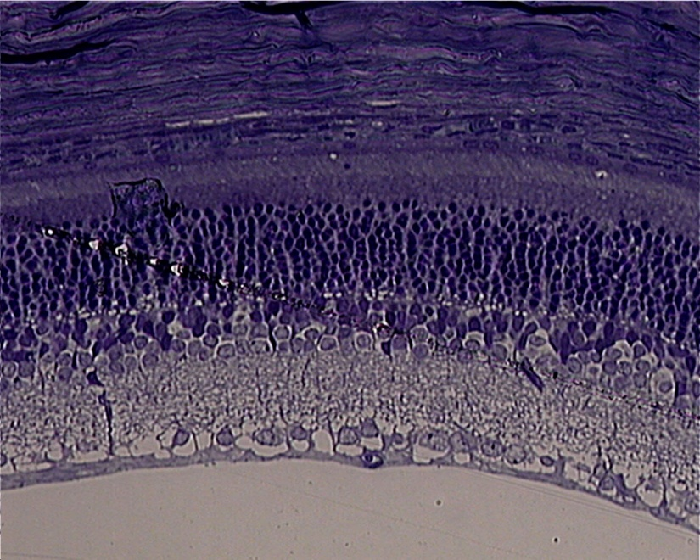
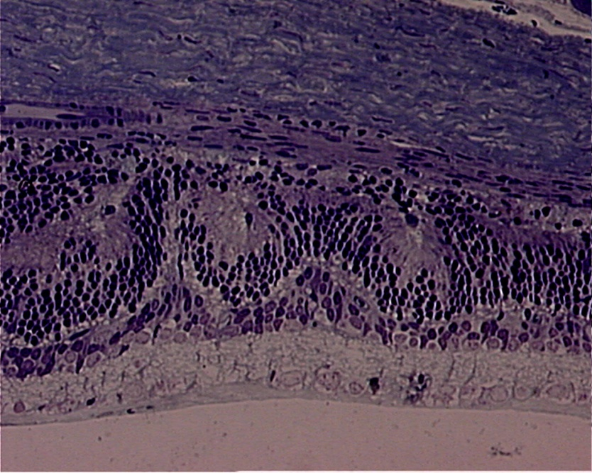
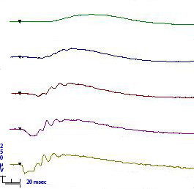
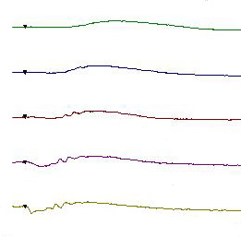
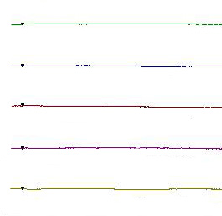
Neuroprotective Effect of Resveratrol on Experimental Retinal Ischemic Injury
Andrew Logemam ¹, Anita P. Vin ¹, H.B. Hu ⁴, Evan B. Stubbs, Jr.^{1,2,6}, Jay I. Perlman^{1,3,5}, Ping Bu^{1,6}
Department of Ophthalmology¹, Neurology², and Pathology³ Loyola University Chicago, Stritch School of Medicine, Maywood, IL.
Department of Medicine⁴, University of Florida, Malcolm Randall VA Medical Center, Gainesville, FL. Surgery⁵, and Research⁶ Edward Hines, Jr. VA Hospital, Hines, IL.
Introduction:
Diseases such as open angle glaucoma and diabetic retinopathy involve increased intraocular pressure, which can damage the retina and lead to vision loss or blindness. Resveratrol is a compound found in grapes, nuts, and red wine and has many health benefits: anti-aging, anti-inflammatory, antioxidant, anti-tumor. Resveratrol has proven to protect the spinal cord, kidneys, and heart from ischemia-reperfusion injury.
Conclusions:
There is a significant difference in ERG function between rats treated with resveratrol and rats treated with a control. This preliminary data implies that resveratrol may be an effective treatment in retinal ischemia diseases.
Results:
Normal Resveratrol Control
References:
Alderton et al. Biochem J 357:593-615 2001
Atten et al. Invest New Drugs 23:111-9 2005
Bu et al. Exp Eye Res 91:104-6 2010
De la Lastra & Villegas. Mol Nutr Food Res 49:405-30 2005
Giovannini et al. J Cardiovasc Pharmacol 37:262-70 2001
Huang et al. Life Sci 69:1057-65 2001
Hughes WF. Exp Eye Res 53:573-82 1991
Kim et al. Exp Brain Res 121:419-24 1998
Kubota et al. Am J Pathol 177:1725-31 2010
Mokni et al. Arch Biochem Biophys 457:1-6 2007
Peng et al. Exp Eye Res 86:637-46 2008
Perlman et al. Curr Eye Res 15:589-96 1996
Ray et al. Free Radic Biol Med 27:170-9 1999
Tsai et al. J Vasc Surg 46:346-53 2007
Figure 2. Morphological Changes in Retina Following Ischemic Injury. Shown are sections of normal, resveratrol-treated, and control-treated retinas that were treated with toluidine blue.
Objectives:
This experiment is trying to observe a neuroprotective effect of resveratrol on retinal cells that are subjected to increased intraocular pressure.
Dark-adapted stimulus intensity (cds/m²)
Normal Resveratrol Control
Methods:
Adult male Sprague Dawley rats received either resveratrol (30 mg/kg) or a control (30% Solutol HS 15 in 0.9% saline) mixture of equal amounts for 5 days. On the third day of treatment, the rats underwent 45 minutes retinal ischemia by increasing their intraocular pressure. Retinal functioning was determined by electroretinographic changes of dark-adapted rats before treatment and a week after the ischemic insult.
.001
.01
.058
.991
24.9
Figure 1. Effects of Resveratrol Treatment on Retinal Function Following Ischemic Insult: (Upper Panel) The quantitative changes in a-waves and b-waves are shown. Pre-injury, prior to ischemic insult; Resveratrol and Vehicle, one week following ischemic insult.
(Lower Panels) ERG data was gathered from Sprague Dawley rats treated with either a resveratrol (30 mg/kg) or control (30% Solutol HS 15 in 0.9% saline) mixture. These tracings were taken before the ischemic-injury (normal), and one week after the ischemic-injury (Resveratrol and Control).
Acknowledgements: This work was supported by The Richard A. Perritt Charitable Foundation and Illinois Society for the Prevention of Blindness (ISPB).

