Slide 1
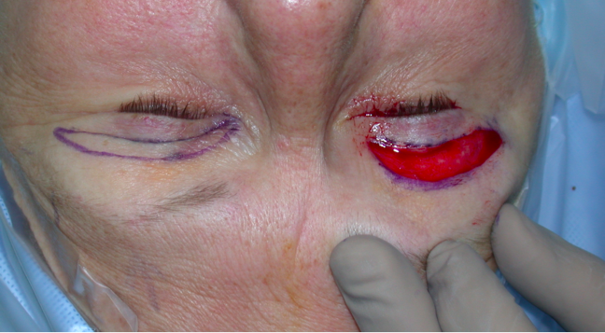
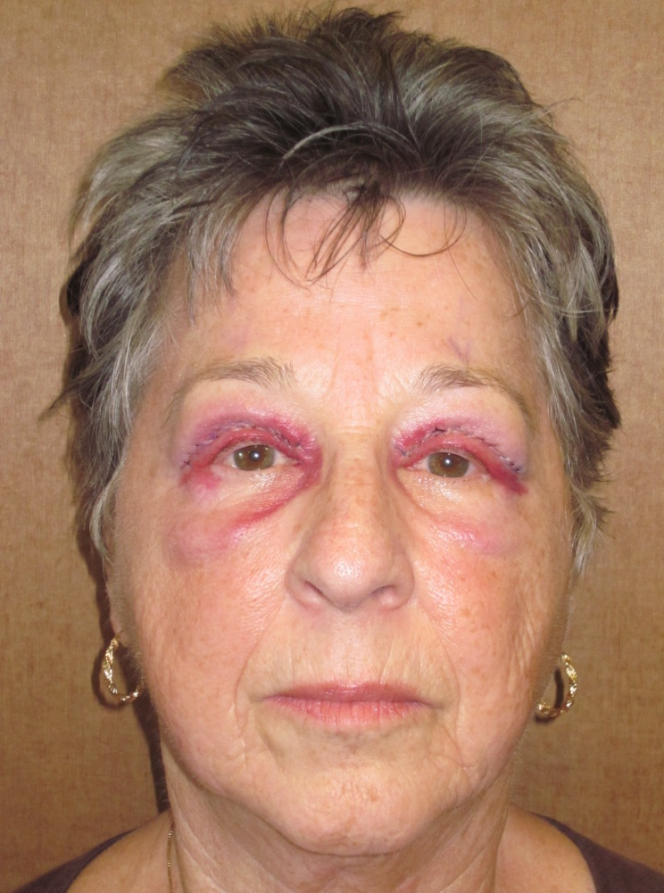
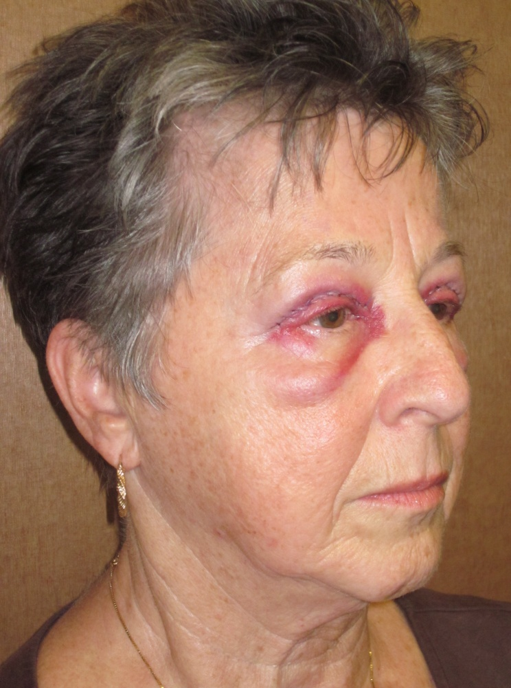
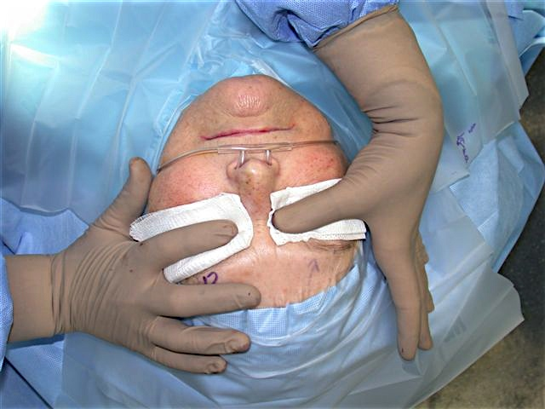
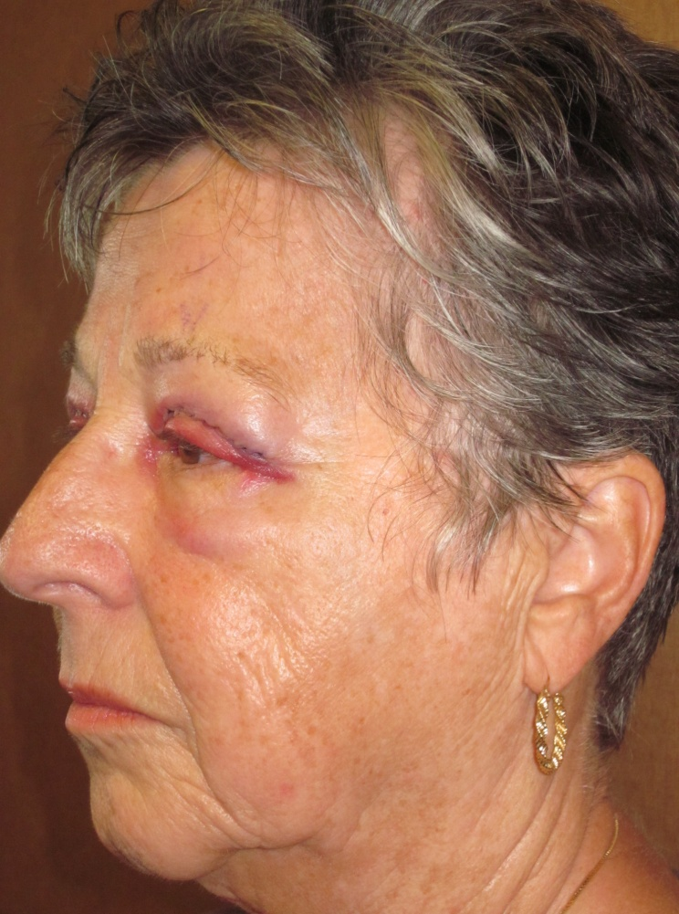
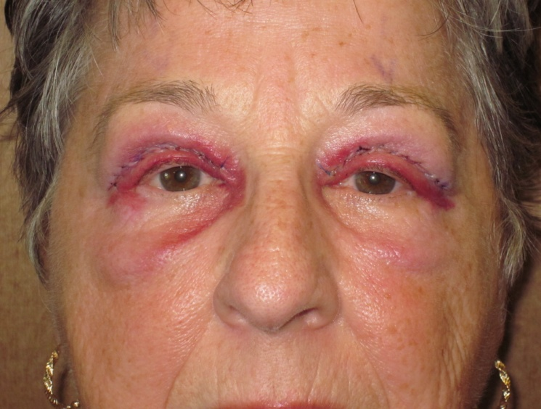
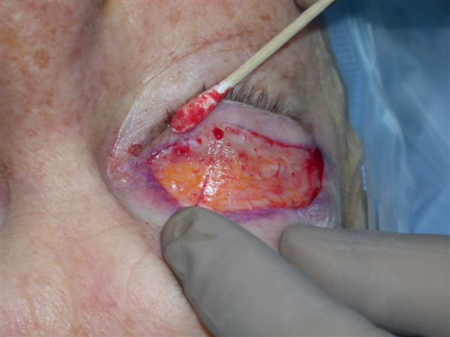
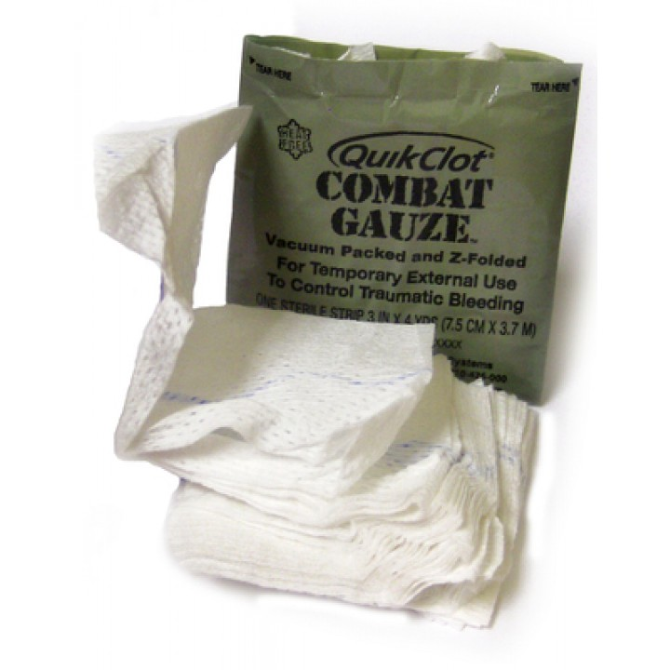
Kaolin Impregnated Gauze in Oculoplastic Surgery
Srinivas Sai A. Kondapalli, Craig N. Czyz, Kenneth V. Cahill, Jill A. Foster, Robert H. Hill
The Eye Center of Columbus, Columbus, Ohio
Introduction
Methods
Methods cont.
Results cont.
Perioperative bleeding is a complication of any invasive surgical procedure and is associated with increased morbidity and mortality in the postoperative period. Frequently, uncontrolled perioperative bleeding requires exploration of the wound, evacuating any hemorrhage, and identifying the bleeding vessels.
Surgical hemostasis is typically accomplished by cauterizing the bleeding vessel with an electrical current, forming a clot. However, cautery has been shown to cause thermal damage to surrounding tissues, and excessive use may result in tissue necrosis. Other methods to control intraoperative bleeding include application of direct pressure or ligating the bleeding vessel with a suture, both can significantly increase operative time. Kaolin, a naturally occurring mineral that is known to promote clotting in vitro.
Kaolin is a naturally occurring silicate mineral derived from clay. It has been widely used and anecdotally noted to promote wound healing and reduce scar formation. In fact, some patients use china clay, a kaolin concentrated earth product, for homeopathic management of wounds. Kaolin activates clotting factors XI and XII when exposed to plasma, accelerating the clotting cascade. It also fosters platelet adhesion and adsorbs water from blood.
Numerous studies from trauma and emergency medicine show Kaolin impregnated gauze to be safe and effective in controlling hemorrhage in extremity and abdominal sites. In addition, the United States Military provides a kaolin impregnated gauze, called QuickClot ®Combat Gauze ™ (Z-Medica, ), in the first aid packs of frontline soldiers. Our study will look at the application of kaolin to control perioperative bleeding and promote wound healing in eyelid surgeries.
To examine the benefit, if any, of kaolin-impregnated gauze in oculoplastic surgery.
Note if kaolin-impregnated gauze limits the use of electrocautery intraoperatively
Investigate if kaolin-impregnated gauze provides any subjective benefit in the wound appearance and pain in the post-operative period to the patient
Examine kaolin-impregnated gauze benefit in wound healing in the post-operative period via postoperative pictures
This prospective, randomized, double blinded study recruited patients who underwent bilateral functional or cosmetic blepharoplasty or ptosis repair.
After the initial incisions were performed, and skin was removed, a 4x4 piece of sterilized of kaolin impregnated gauze was placed on one side and moistened cotton gauze on the other. Each gauze was left in place with gentle finger pressure for four and a half minutes. After the time duration, the gauze was removed.
Individual areas of bleeding were noted, recorded, and addressed with electrocautery. The remainder of the surgery proceeded in a standard fashion.
Standardized postoperative photographs were obtained on day one, three and seven. The photographs were graded for edema and ecchymosis by four blinded oculoplastic surgeons. The data was analyzed using the appropriate statistical tests for data type. Patients also completed self-assessment questionnaire at each visit asking them to compare which side was more bruised, painful and swollen. The data was analyzed using the appropriate statistical tests for data type.
Forty-six patients were enrolled after IRB approved consent was obtained. Three patients had Bilateral direct brow procedure in addition to bilateral upper lid blepharoplasty. Three patients underwent bilateral external levator advancement. The remainder of patients underwent bilateral upper blepharoplasty. Five patients were lost in follow-up.
 | Total CG Side Superior | Total CG Side Inferior | p-value
Pain POD 1 | 9 | 17 | 0.17
Pain POD 4 | 9 | 11 | 0.82
Pain POD 7 | 8 | 11 | 0.65
Edema POD 1 | 11 | 22 | 0.08
Edema POD 4 | 10 | 26 | 0.01
Edema POD 7 | 15 | 18 | 0.73
Bruising POD 1 | 11 | 18 | 0.26
Bruising POD 4 | 17 | 18 | 0.99
Bruising POD 7 | 20 | 18 | 0.87
Table 2. Patient self grading results.
 | Total CG Side Superior | Total CG Side Inferior | p-value
Bruising POD 1 | 37 | 31 | 0.54
Bruising POD 4 | 48 | 31 | 0.07
Bruising POD 7 | 53 | 39 | 0.18
Edema POD 1 | 21 | 31 | 0.21
Edema POD 4 | 21 | 20 | 0.99
Edema POD 7 | 20 | 32 | 0.13
Objectives
Fig. 1. Initial skin incisions made (top), cotton gauze (left) and kaolin impregnated gauze (right) in place for 4.5 minutes
Fig 3. Example of post-operative day 1 photographs
Results
Table 3. Gradings of post-operative photographs.
Conclusions
The use of kaolin for hemostasis and wound healing in eyelid surgery showed no benefit to either the surgeon of patient. Intraoperative hemostasis, graded on the number of “bleeders,” was not reduced by kaolin-impregnated gauze. In evaluating post-operative edema and ecchymosis, neither patients nor blinded oculoplastic surgeons noted improvement in wounds treated with kaolin-impregnated gauze. Of note, none of the forty-six patients had any recorded adverse side effects.
The contrasting usefulness of kaolin in other anatomical locations highlights the importance of dedicated research on wound healing of periocular tissues.
 | Combat Gauze Side | Non-Combat Gauze Side
Total number of Bleeders in 49 patients | 230 | 231
Average number of bleeders | 4.7 | 4.7
P-value | 0.96
Fig 2. “Bleeder” (arrow)
Table 1. Number of intraoperative “bleeders.”
Srinivas Sai A. Kondapalli
The Eye Center of Columbus
skondap@gmail.com
Contact

